Slide 1
Microservice Architecture on Kubernetes
Huseyin BABAL
Senior Software & DevOps Consultant

Slide 2
Who Am I?
Senior Software & DevOps Consultant
Ex-Sony and Ex-eBay Engineer (Microservice Transformation Project Architect)
Organizer of Docker Istanbul, NodeSchool Istanbul, DevOps Underground meetups

Slide 3
#1 Kubernetes Overview

Slide 4
What is it?
Open-source platform for managing containerized workloads and services.

Slide 5
How to use?
You can see managed versions of kubernetes on Google Cloud, AWS, and Azure. You can use kubespray to deploy k8s on datacenter.
We will focused on architectural overview rather than how to install k8s from now on.

Slide 6
#2 Cluster Environment Architecture

Slide 7
When you use k8s, you will forget about infrastructure level operations and mainly focus on architecting your applications.

Slide 8
Environments
According to your needs, you may need different environments like dev, staging, prod for different purposes. Let see how we can do this.

Slide 9
Cluster Level Isolation
You can setup cluster per environment to have maximum isolation.
Cluster 1
Cluster 2
Cluster 3
Dev
Staging
Prod

Slide 10
Namespace Level Isolation
You can create namespace per environment to isolate them
Cluster
Dev
Staging
Prod

Slide 11
Tip
Do not put all the things in default namespace, it will be very hard to manage them in the future. If you want to put all the things in default namespace, you will need to have good labelling on your pods to filter them based on needs

Slide 12
monitoring
microservice
worker
Prometheus
Grafana
Unsee
Product Service
User Service
Category Service
Payment Service
Payment Worker
Scoring Worker
Billing Worker

Slide 13
Good Tools for Daily Kubernetes
kubectx: A tool for managing your kubernetes context
kubens: A tool for managing your kubernetes namespace
Thanks Ahmet Alp Balkan for those wonderful tools
https://github.com/ahmetb

Slide 14

Kubectx

Slide 15

Kubens

Slide 16
#3 Monitoring

Slide 17
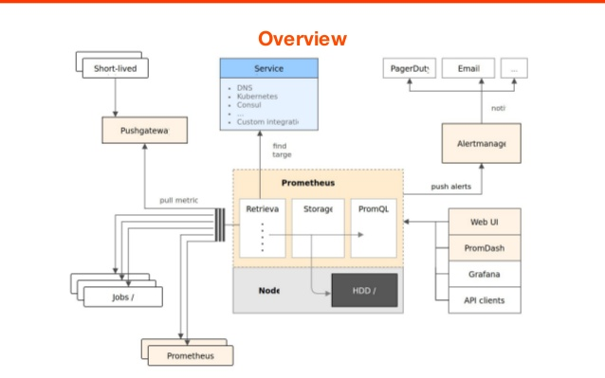
Monitor Everything

Slide 18
Prometheus
Prometheus is capable of collecting metrics from known sources like cAdvisor. Prometheus is mainly used for collecting metrics and alert manager to notify you on any kind of problem

Slide 19
Prometheus Operator
Hopefully, CoreOS team developed a project called prometheus operator to collect k8s specific metrics automatically.
https://github.com/coreos/prometheus-operator

Slide 20
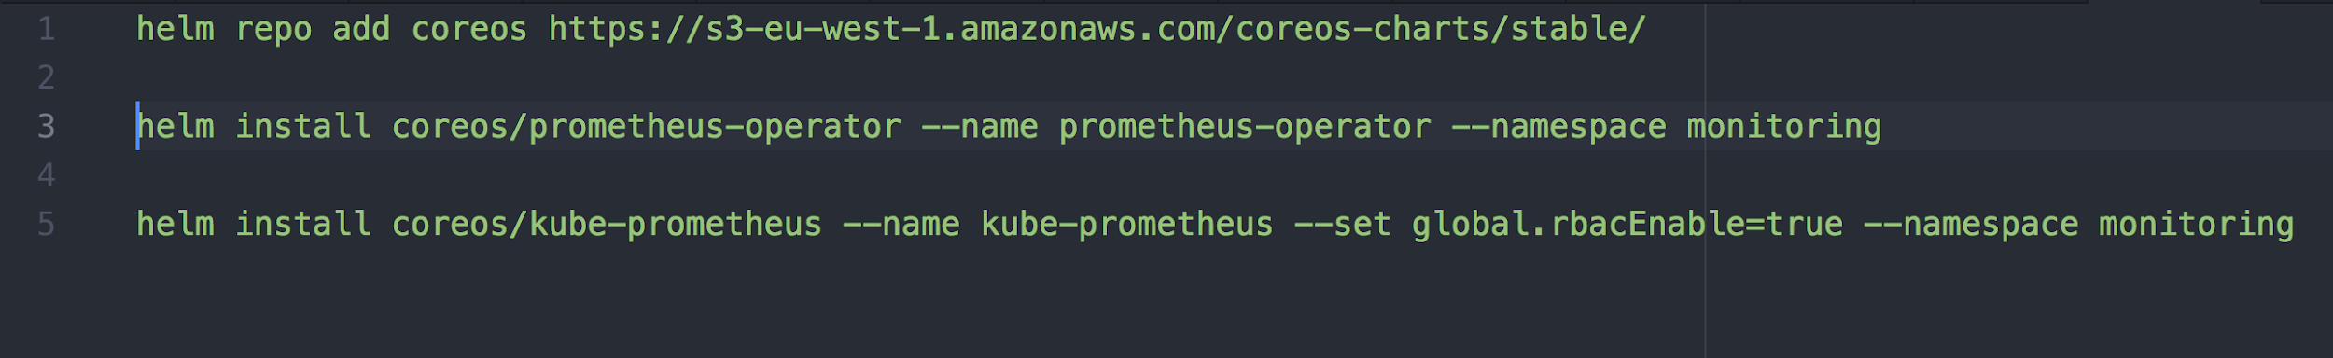
Getting Started
You can install Prometheus with Helm charts

Slide 21
Visualization
Prometheus lets us to keep track of external services by using some endpoint via exporters. To visualize metrics, we will use grafana.

Slide 22
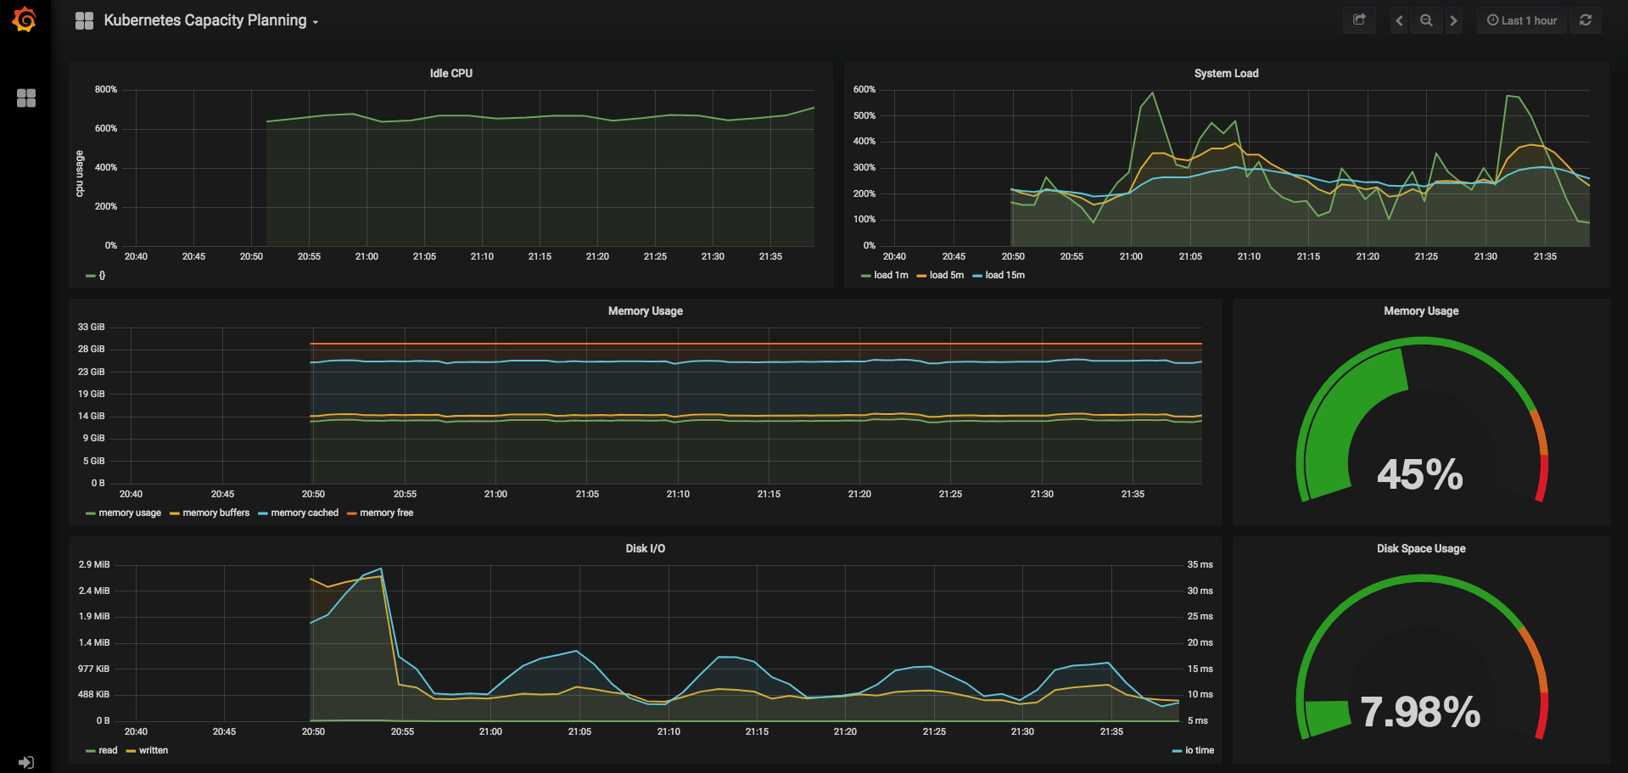

Slide 23
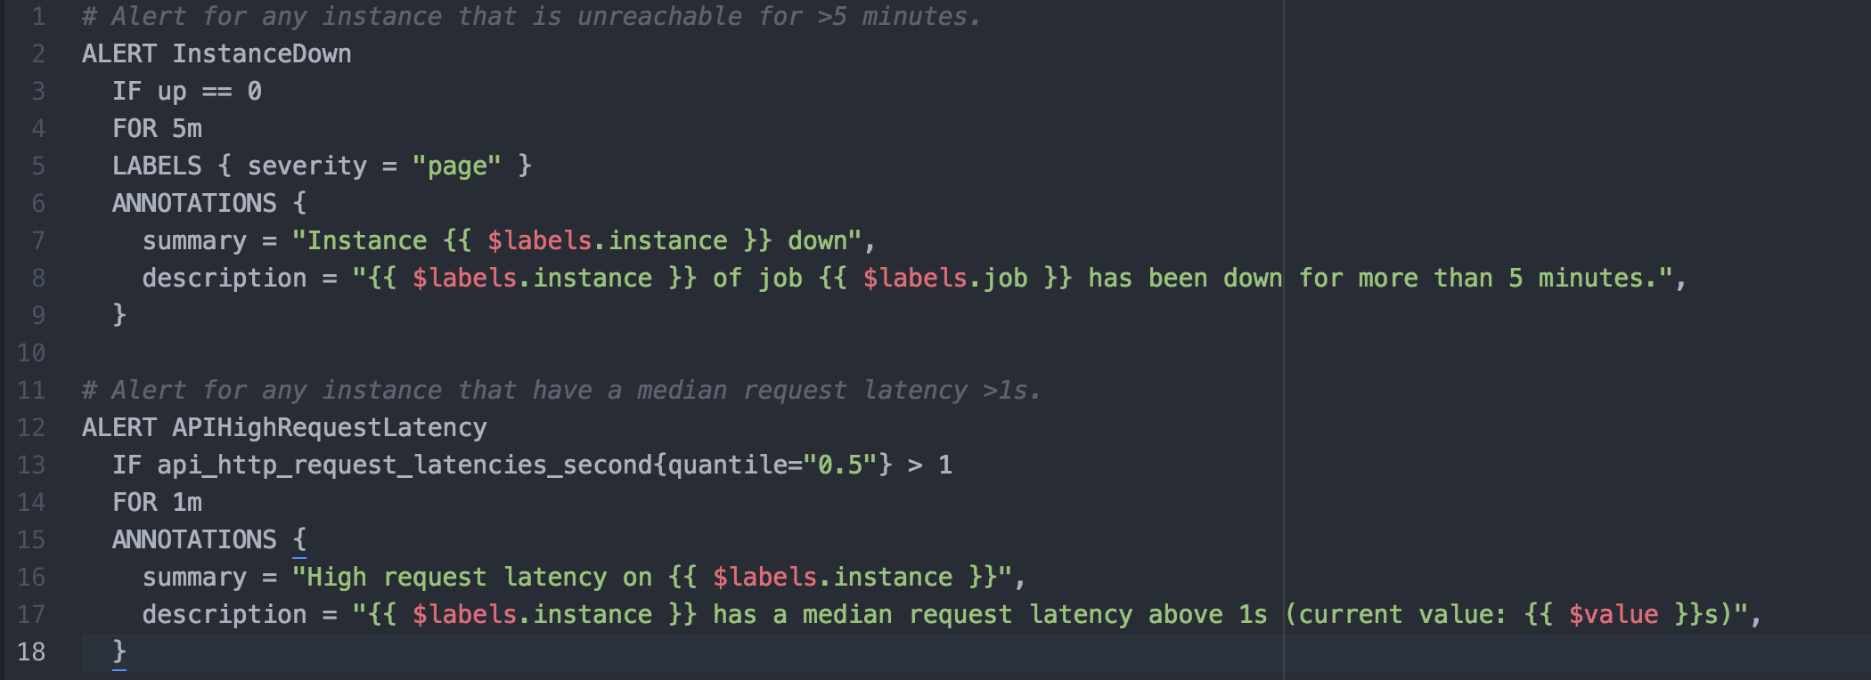
Alert Manager

Slide 24
Monitoring Multiple Clusters
If you have multiple clusters to be monitored, you can use Prometheus Federation. This is simply handled by selection one member as central monitoring member and it is capable of collecting metrics from others.

Slide 25
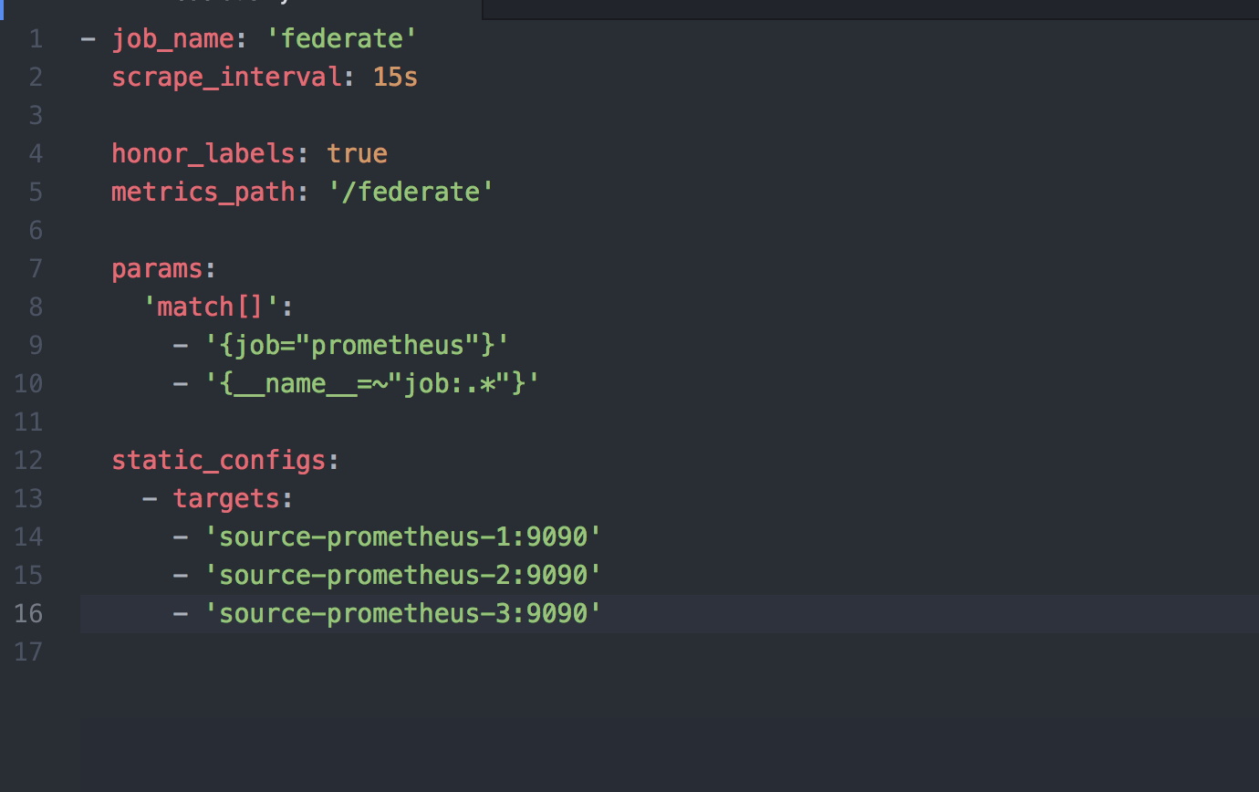
Federation Sample

Slide 26
#4 Public Traffic

Slide 27
Cloud Based Scenario
There are several ways to provide public traffic to k8s cluster, but in this scenario, we will go through a kubernetes cluster exists on AWS.

Slide 28
Nginx Ingress
You can expose your service to the outside in several ways like as LoadBalancer. However, creating an LB for each will be hard to manage and costful. When you deploy Nginx Ingress on kubernetes environment, it will automatically create a Load Balancer.

Slide 29
Route53
If you have managed domain name on Route53, you can simply add a CNAME record to point domain to LB. Every request will be proxied to k8s cluster entrance, but how about pointing to specific service?

Slide 30
Ingress Rules
You can use ingress rule to proxy incoming requests to specific service in k8s.

Slide 31
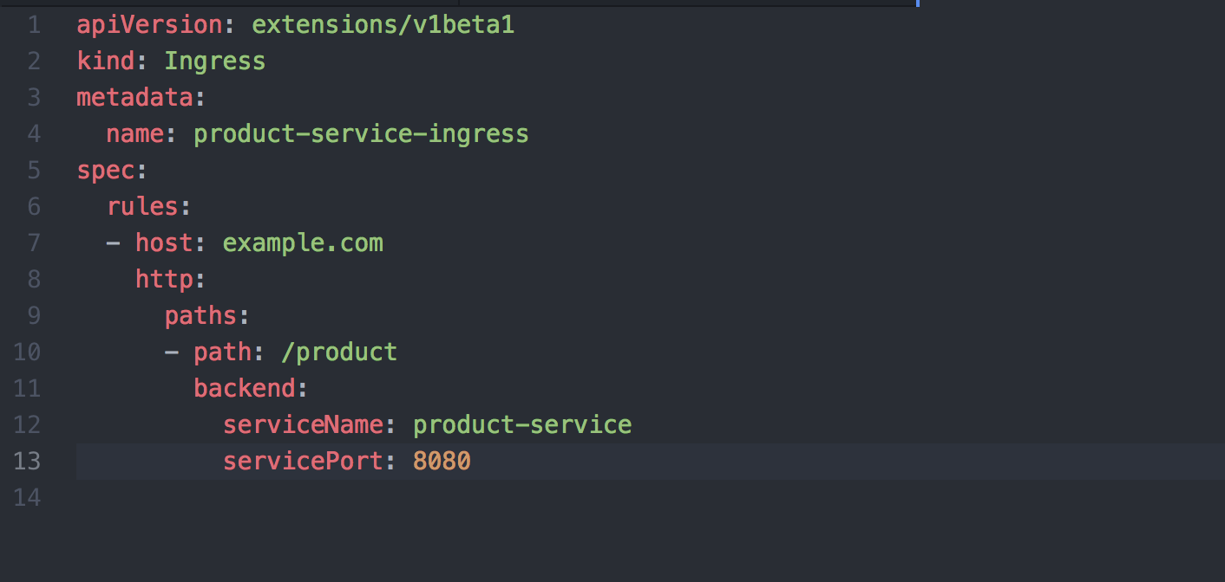

Slide 32
Kubernetes Cluster
Product Service
Nginx Ingress
Route53
Load Balancer
User Service

Slide 33
#5 Microservice Overview

Slide 34

Once upon a time while we are in monolithic app days

Slide 35

After switching to Microservice Architecture ...

Slide 36
And yes, the truth is, only the name Microservice Architecture cannot solve your architectural problems.
You need to consider applying best practices to Microservices to do it in an efficient way

Slide 37
#6 Try to Reach Glory of REST

Slide 38
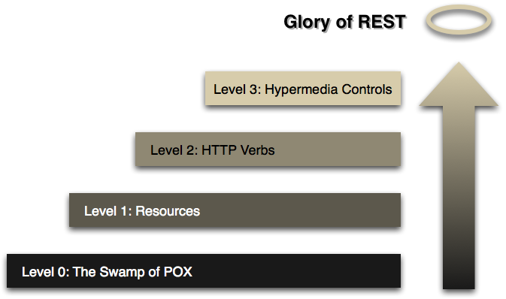
Leonard Richardson’s Maturity Model

Slide 39
#7 k8s Warm-up

Slide 40
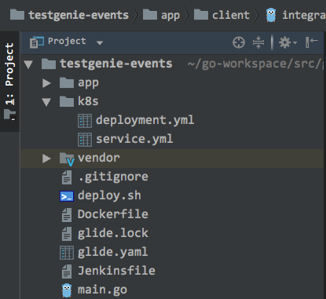
Project Structure

Slide 41
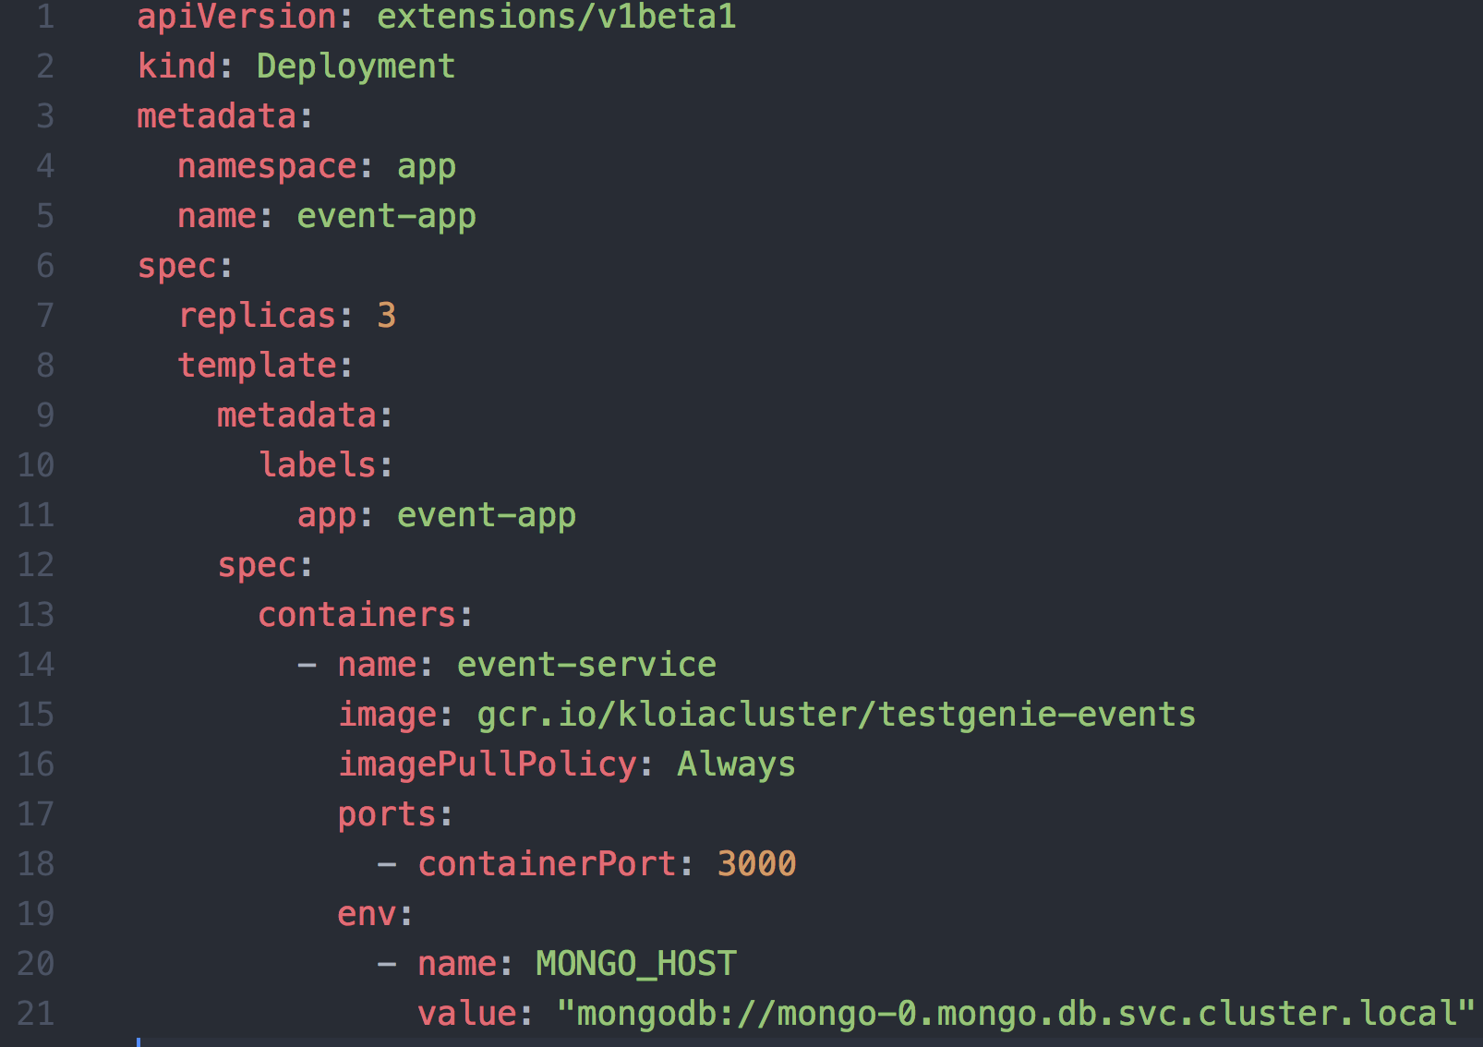
deployment.yml

Slide 42
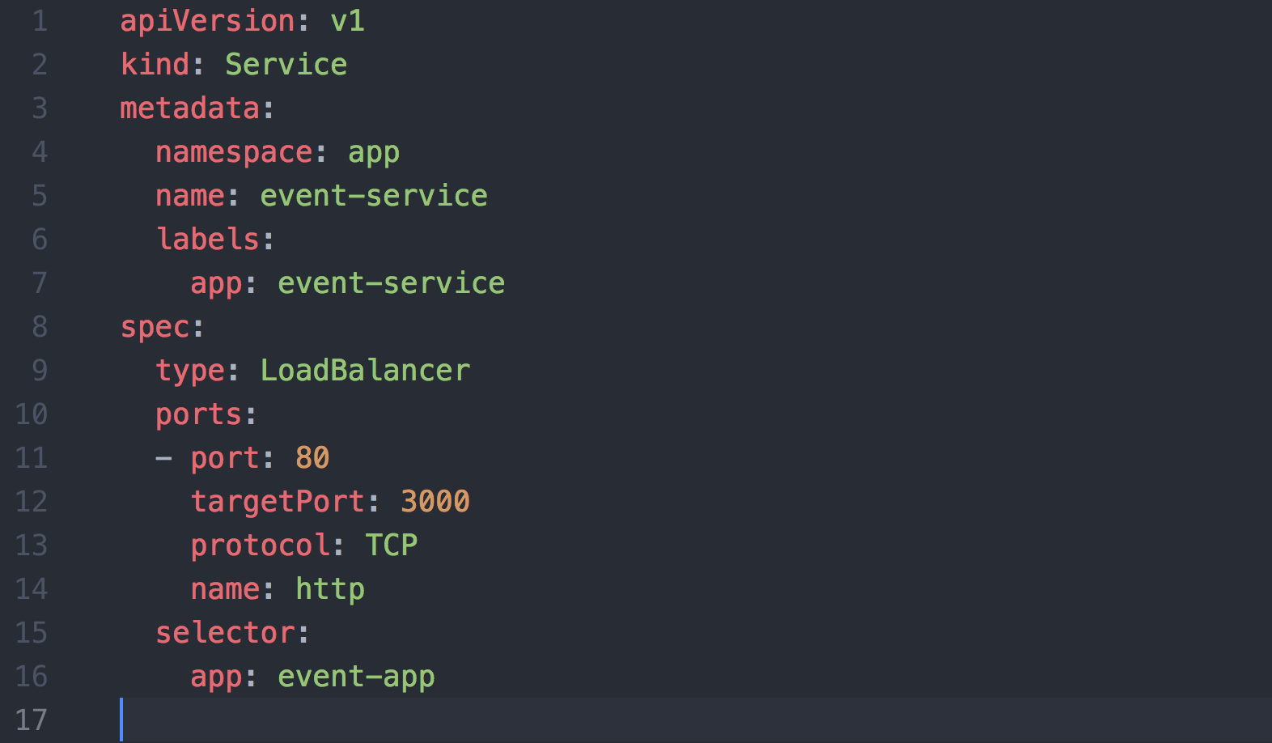
service.yml

Slide 43
Kubectl configuration
Kubectl is a client app for k8s api server in order to manage k8s cluster. If you use minikube, your kubectl will be automatically configured, and it is different for other cloud providers.

Slide 44
Simple deployment
git clone <http://project>
cd <project> kubectl apply -f k8s

Slide 45
Handling Confidential Data
If you have confidential data like db password, api secret, etc… you can store them inside Kubernetes secrets
kubectl -n microservice create secret generic product-service --from-literal=dbpassword=${dbpassword}

Slide 46
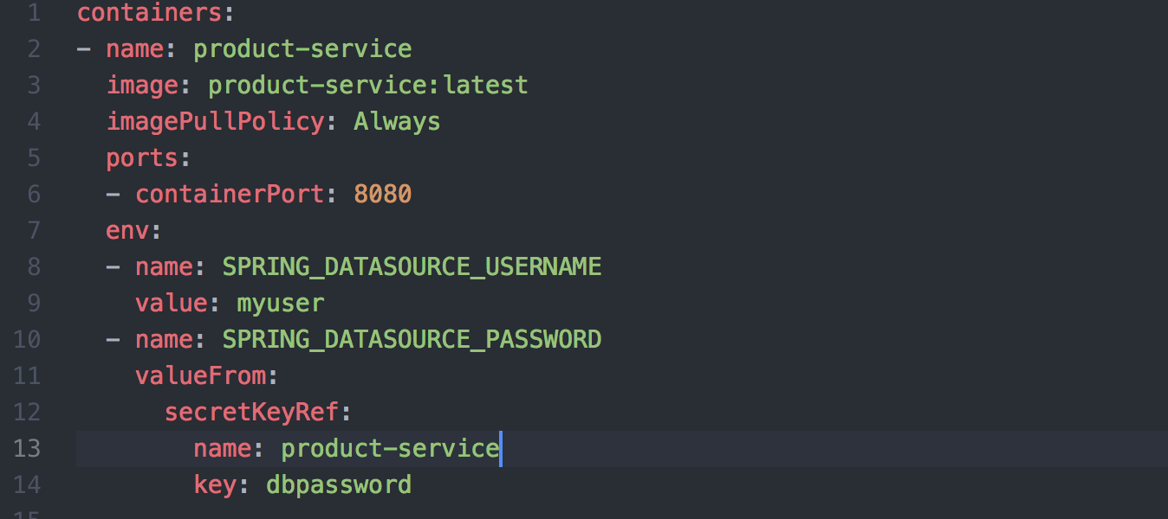

Slide 47
#8 Continuous Deployment

Slide 48



Build
Cloud Provider
Test
Deploy

Slide 49
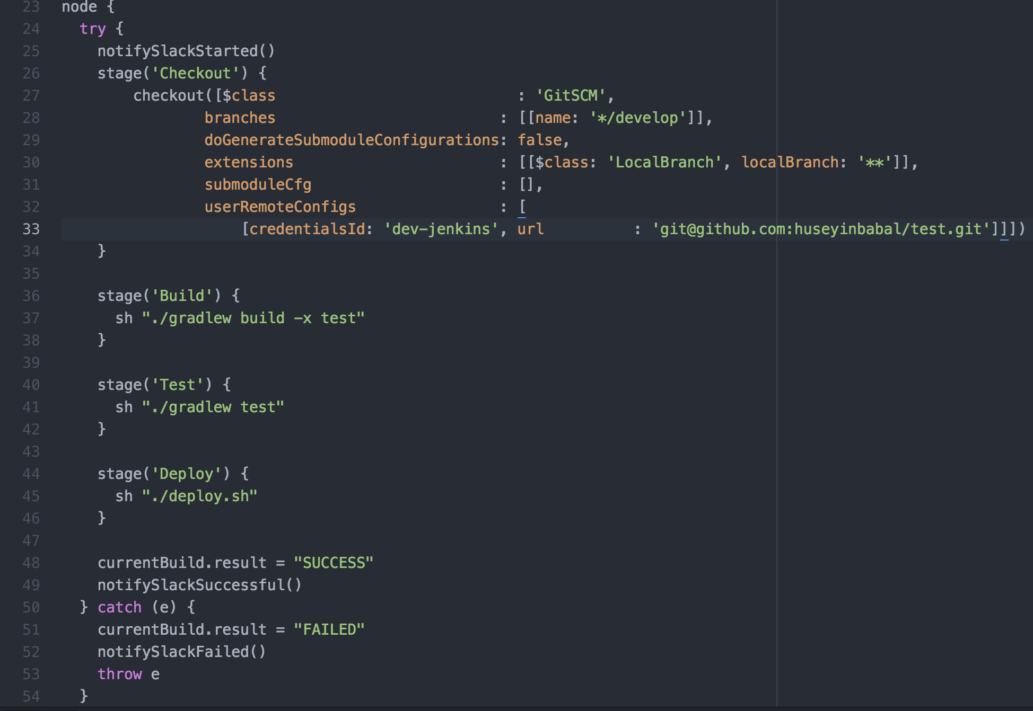

Slide 50
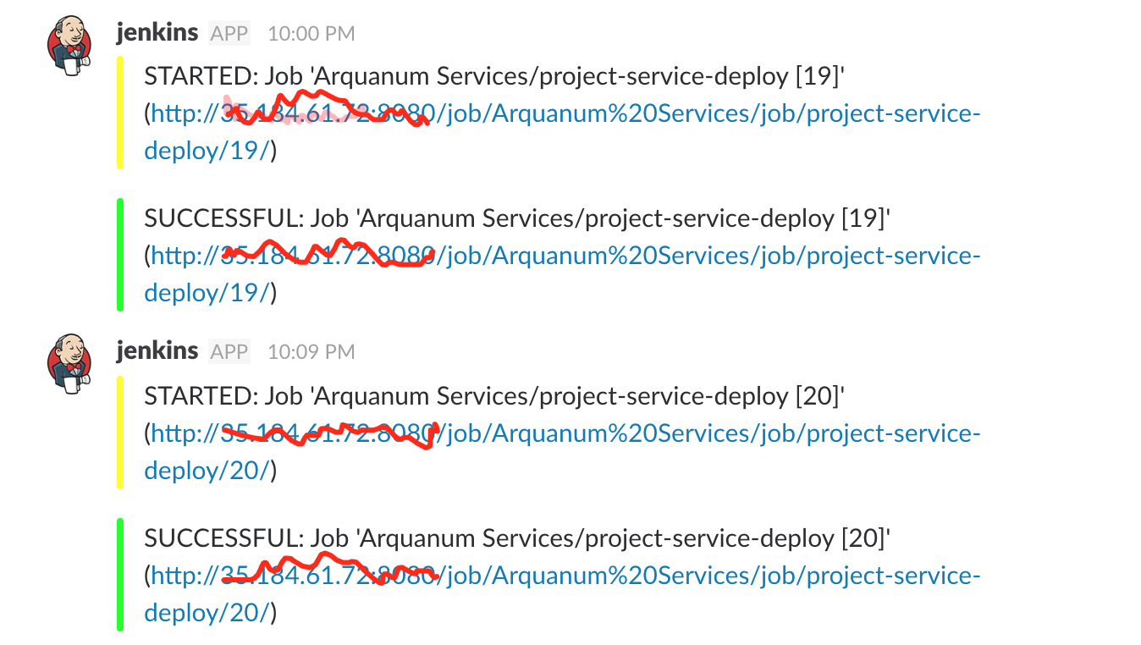
Slack Notifications

Slide 51
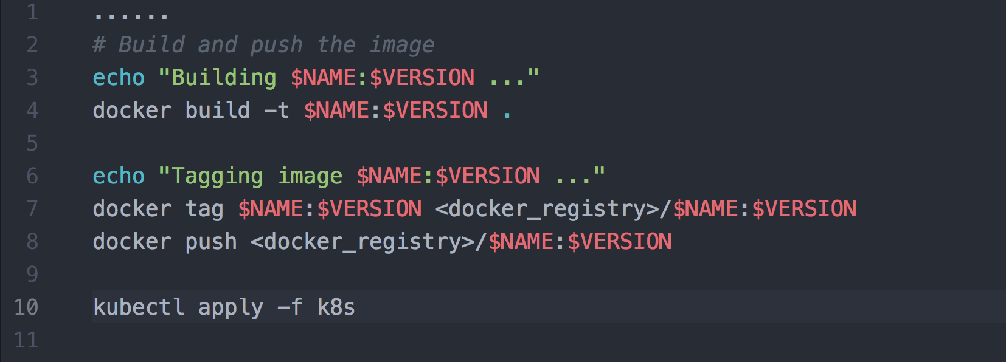
Deployment Script

Slide 52
Deployment Types
Rolling Update
Canary Deployment
Blue / Green Deployment

Slide 53
Rolling Update
Deployment resource on k8s uses RollingUpdate strategy by default. Within this strategy, pods deployed one by one instead of taking entire service down.

Slide 54
Canary Deployment
You deploy an experimental feature and allow small amount of request traffic to this deployment. You increment the size of traffic and after a while, canary replaces the production one

Slide 55
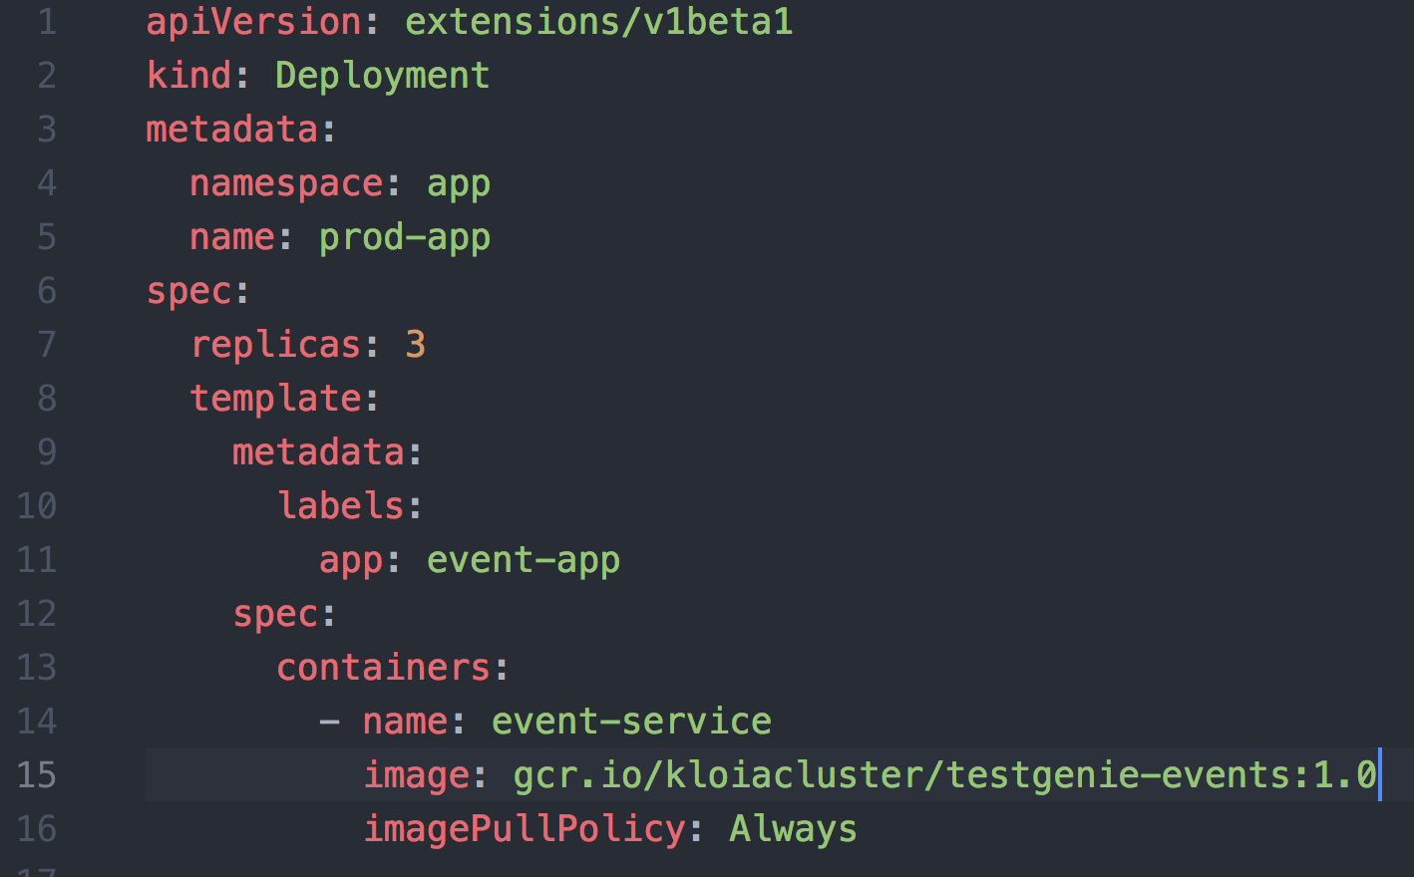

Slide 56
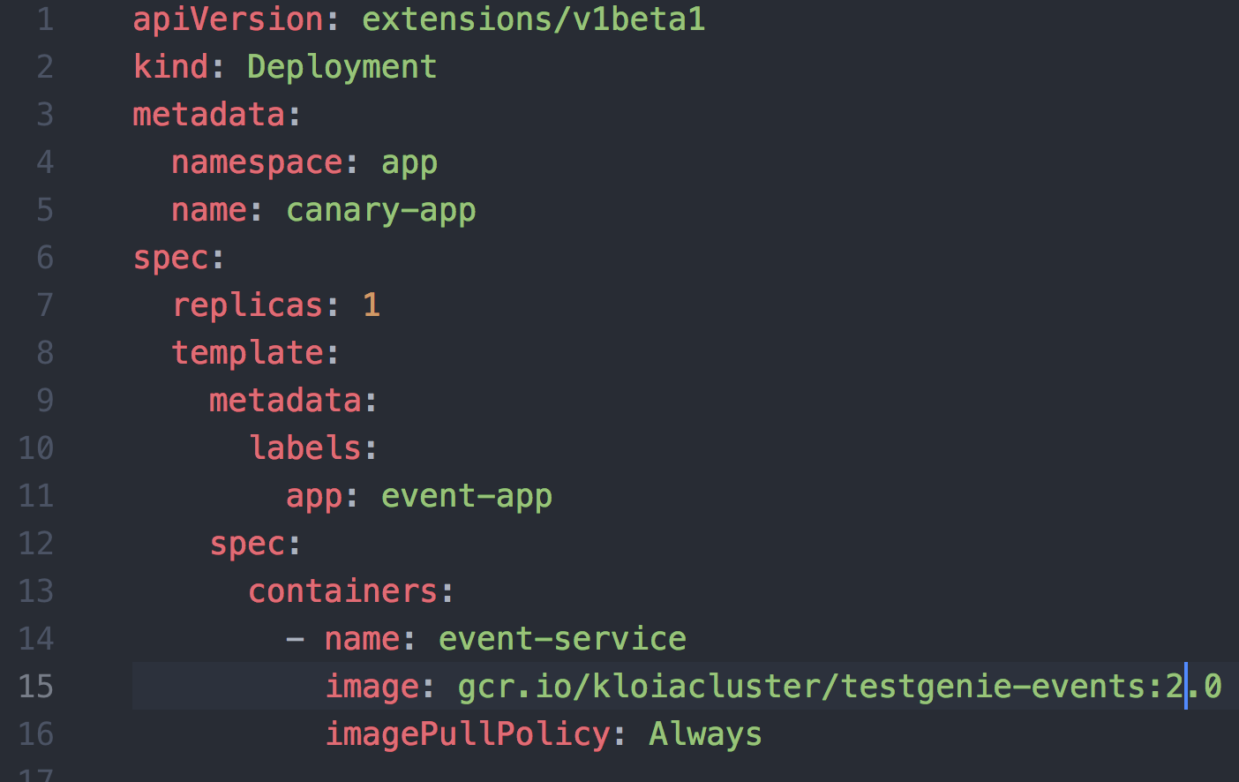

Slide 57
After a while...
You confirmed that, the feature on canary deployment works, replace prod image with canary one and delete canary deployment

Slide 58
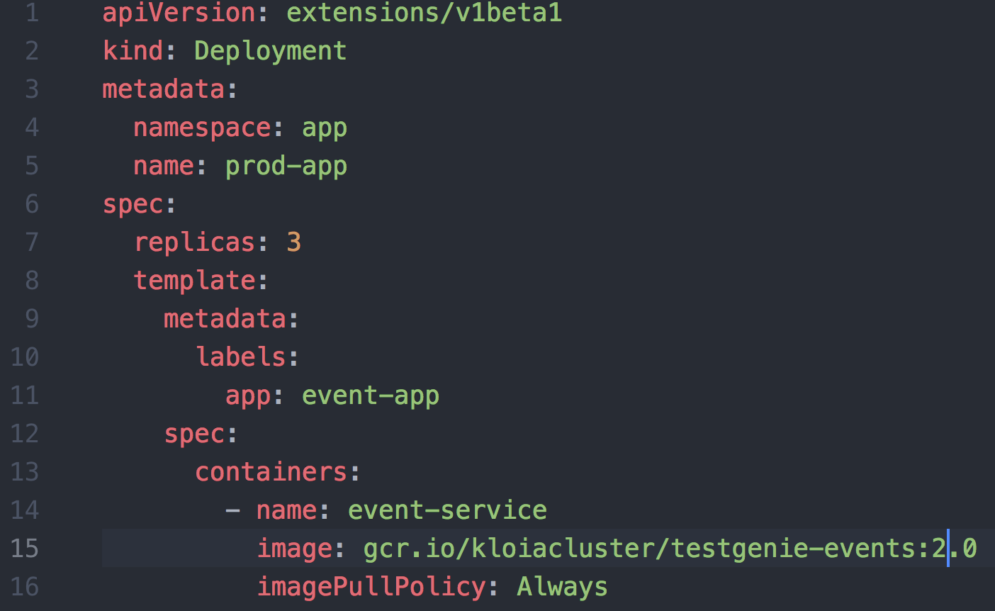

Slide 59
Blue & Green Deployment
In this strategy, there will be 2 environments with same properties except application version. The current version will be called blue and new version will be green. Just update ingress rules to redirect traffic to green deployment.

Slide 60
#9 Distributed Configuration

Slide 61
Why Not Project Specific Configs?
Sensitive data walks around Git
Unable to inherit common properties like spring.main.banner-mode=OFF

Slide 62
How to Centralized Config?
Consul can be used to keep config data as Key/Value
Create a project for just keeping project configurations.
Git2Consul for sync configuration to Consul

Slide 63

Architecture
Git2Consull Daemon
Sync configs to Consul
Polling
User
Config Project
Git push new config change

Slide 64
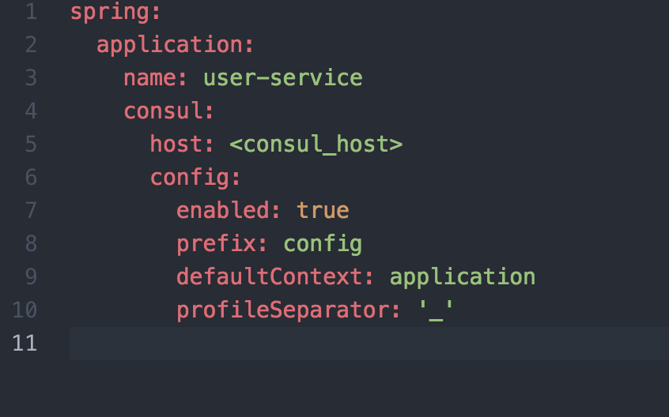
Spring Boot Config

Slide 65
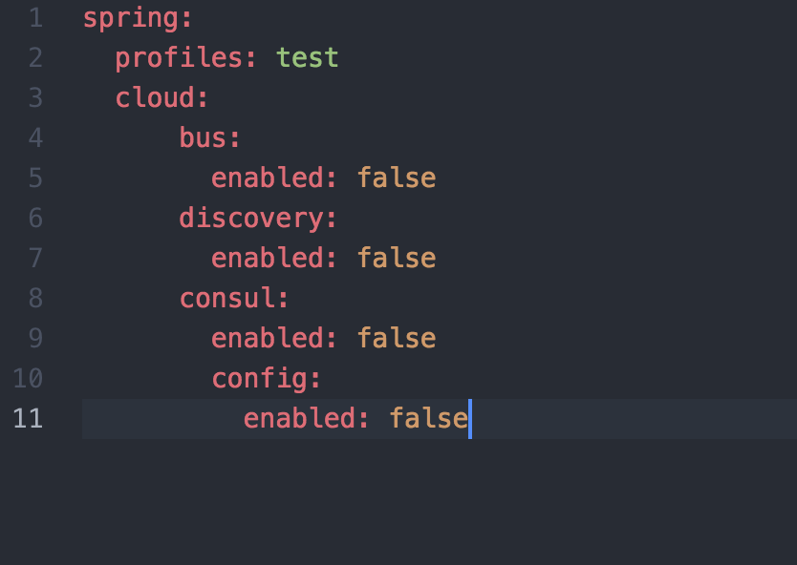
Spring Boot Config (Test)

Slide 66
Git2Consul
npm install -g git2consul
Create a file called git2consul.json and add necessary config
git2consul --endpoint <consul_host> --port 8500 --config-file git2consul.json

Slide 67
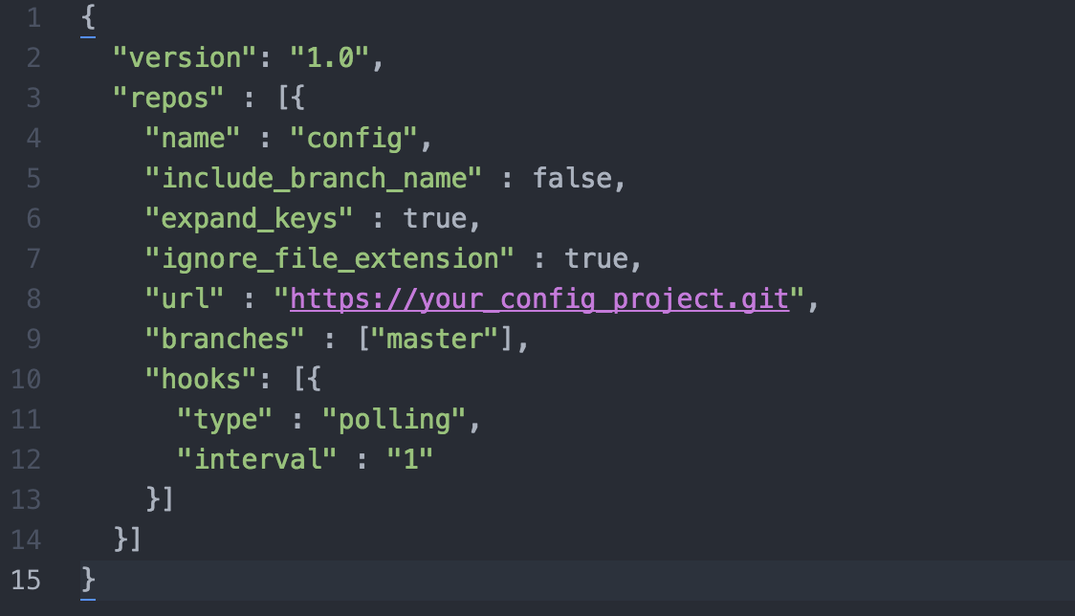
Git2Consul Config File

Slide 68
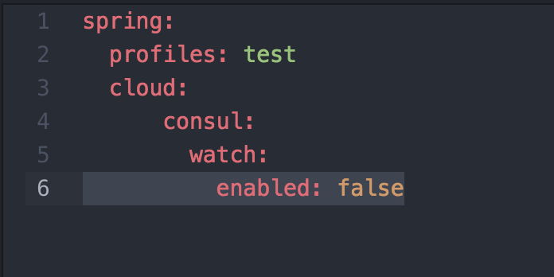
Pro Tip
By default, Spring Boot refreshes its context on config change on Consul. This may cause down time problems, so disable config change watching with following.

Slide 69
#10 Client Code Generation

Slide 70
How?
You can either use Swagger to generate your client code on any supported language, or feign client with a little annotation and client side load balancing with Ribbon.

Slide 71
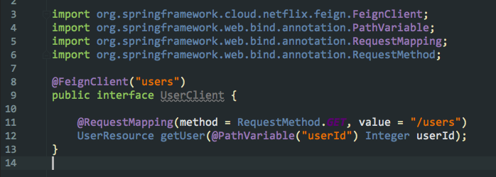
Feign Client

Slide 72
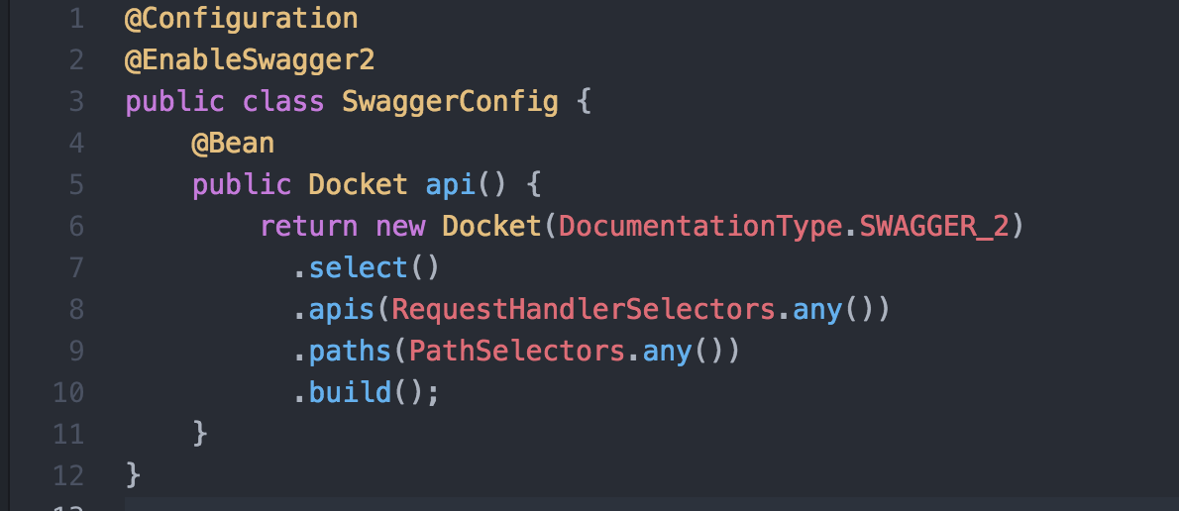
Swagger Doc

Slide 73
Swagger Doc
Now you are able to access;
http://your_api/swagger-ui.html for api documentation
http://your_api/v2/api-docs for json specification of API doc.

Slide 74
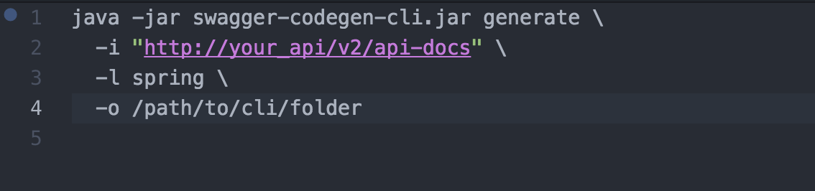
Swagger Codegen

Slide 75
Pro Tip
The best place to generate api client is while Jenkins build section.
If you are deploying a feature to non-prod environment you can generate client library with snapshot version and push to nexus.
If you are deploying a feature to prod environment, you can generate client with stable and push to nexus artifactory

Slide 76
#11 Logging

Slide 77
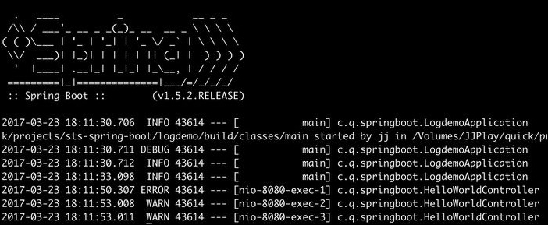
Spring Boot Logging

Slide 78
Logging Types
Node Level Logging
Cluster Level Logging

Slide 79
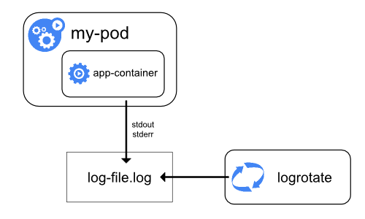
Node Level Logging

Slide 80
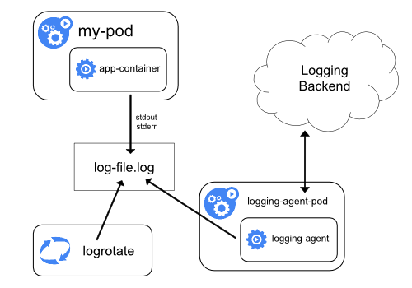
Cluster-Level Logging

Slide 81
You can use several technology to send your logs to logging backend. It can be Graylog, ELK, etc...

Slide 82
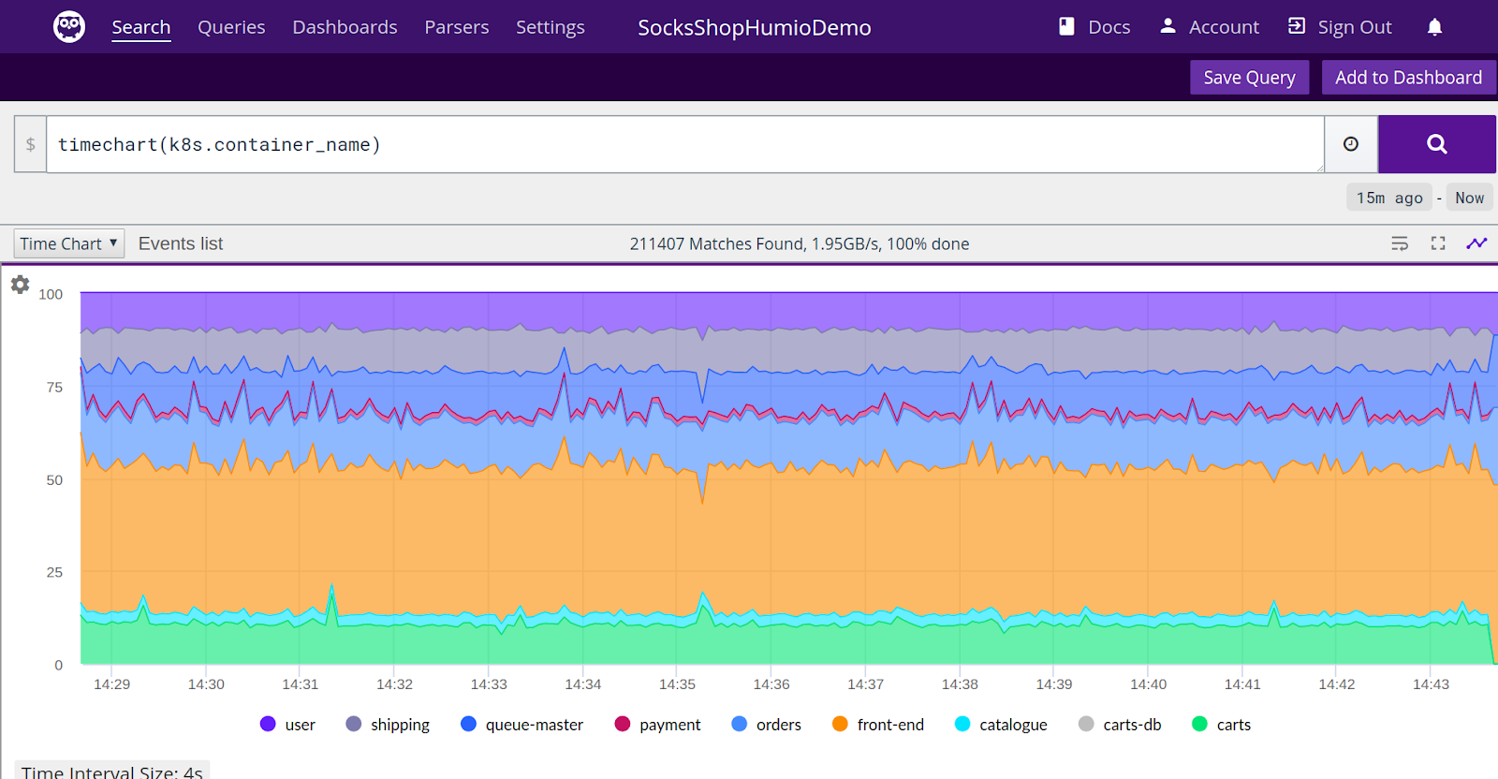

Slide 83
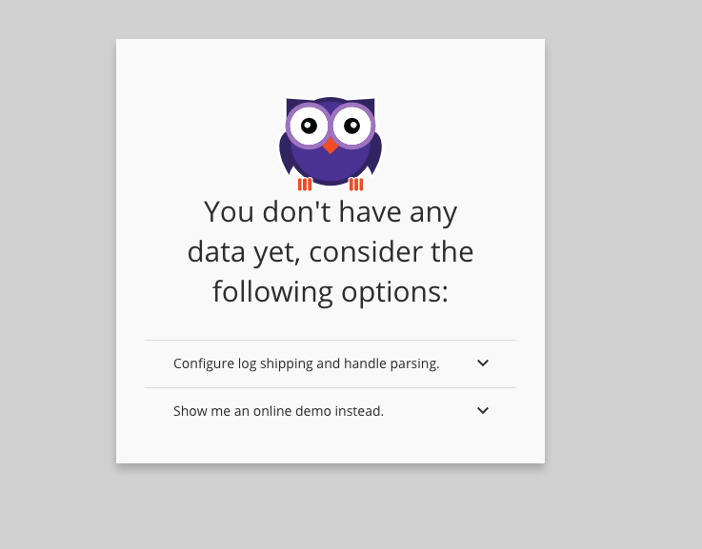
Humio

Slide 84
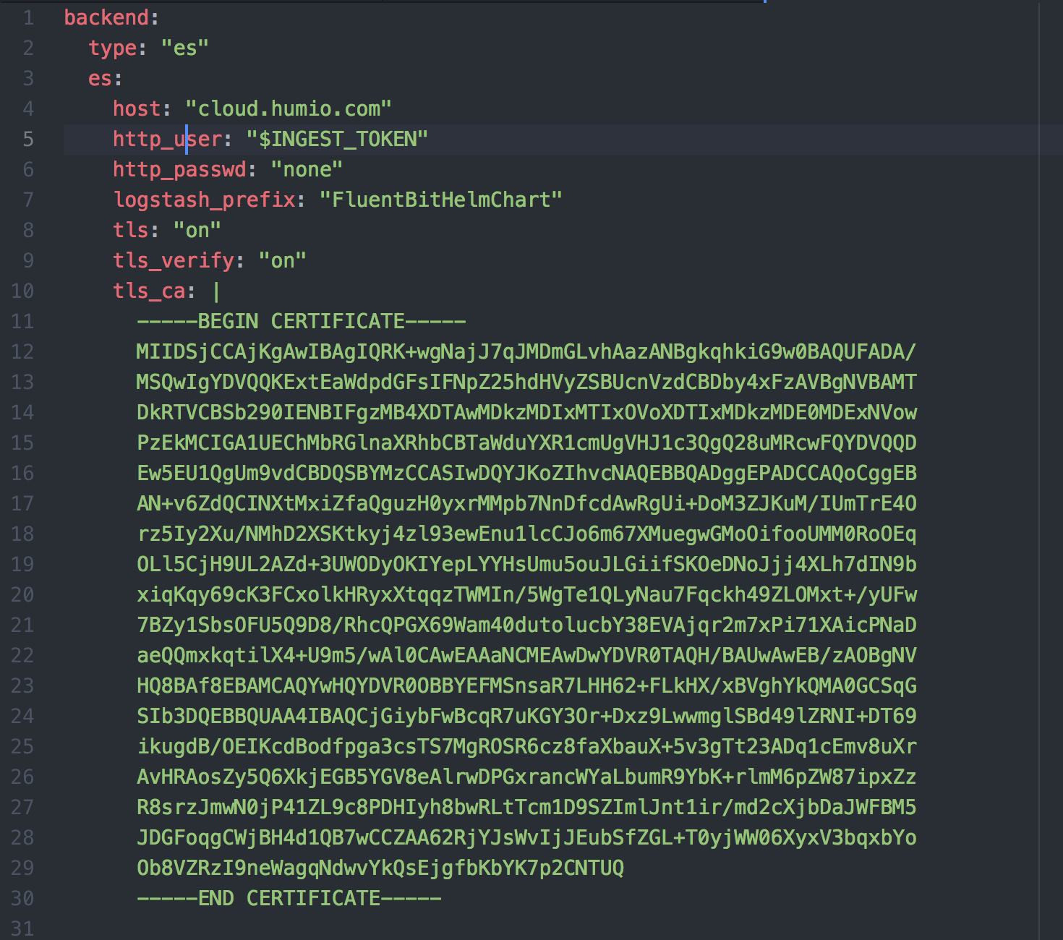

Slide 85
Installation
helm install --version "v0.8.0" stable/fluent-bit --name=humio-agent -f humio-agent.yaml

Slide 86
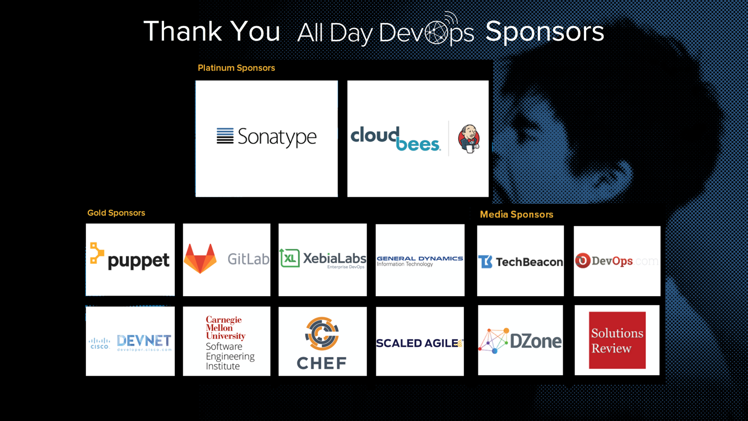

Slide 87
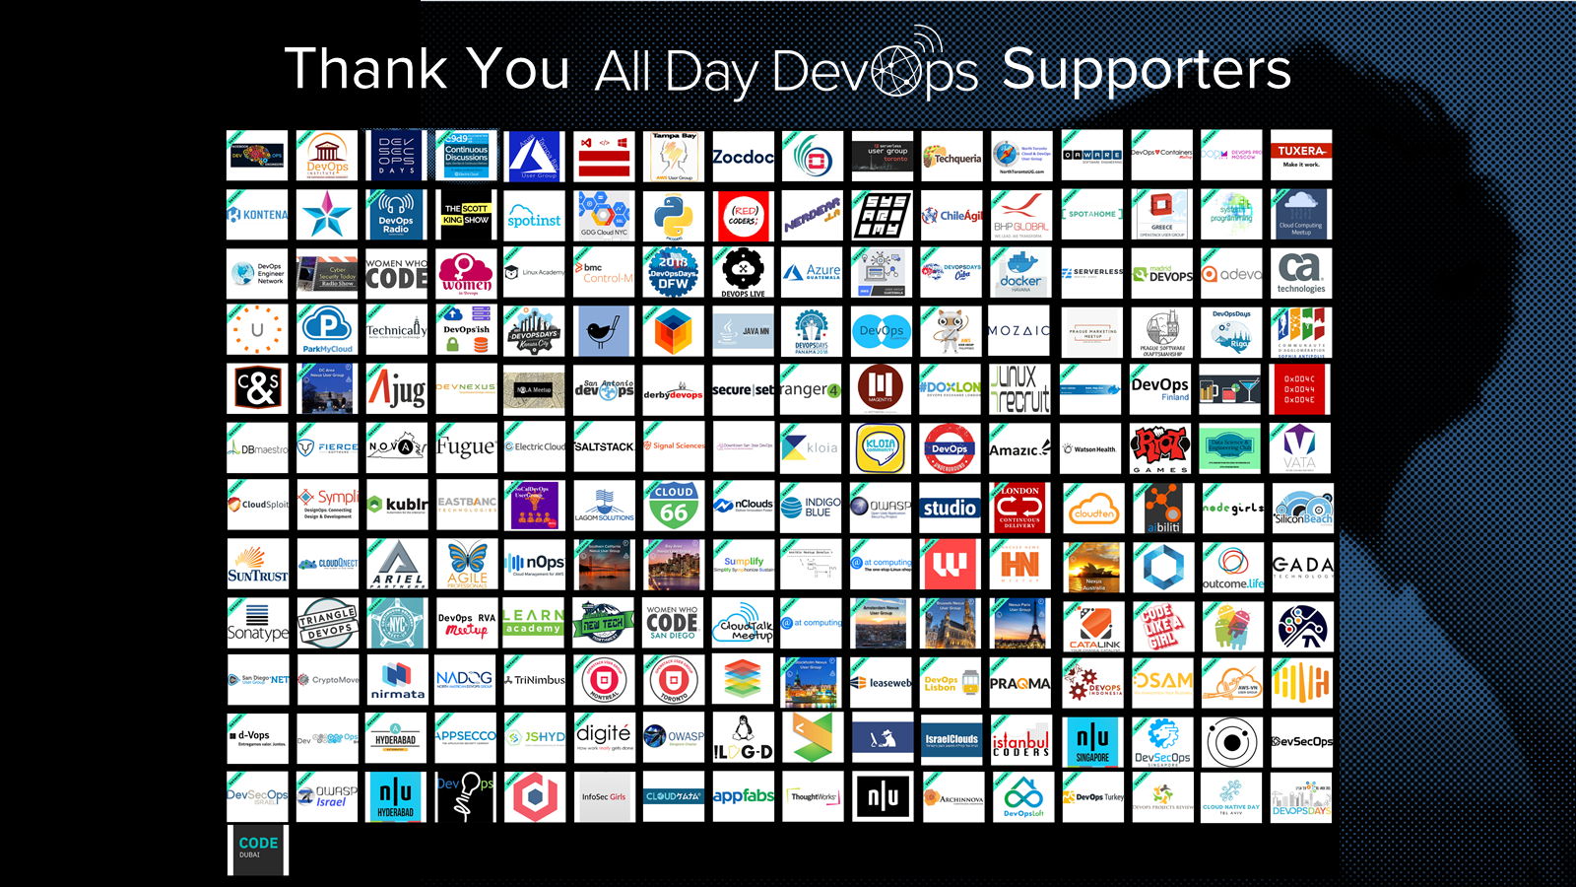

Slide 88
